Slide 1
CAPSTONE PRESENTATION
By Hashley beedah
Database App for Personal trainers to manage their fitness business

Slide 2

Content
Overview
App Idea
Testing
Libraries used
User Flow Diagrams
Future Plans
Demo
Conclusion

Slide 3

Overview
General features:
Login/Sign up
Create workout plan for clients
Add new profiles and manage info
Chat with clients
Book consultations/workout session with clients
Create and post fitness Challenges

Slide 4

App idea
Personal Experience.
Research most popular fitness apps, their functionality and costs.
Asked PTs at the gym what would make their jobs easier.

Slide 5
Testing
Bruno/Swagger – Get, Post, Put and Delete requests
Localhost
Console log
Frontend UI

Slide 6
libraries used
Material UI
Fullcalendar
Fortawesome
Axios
MongoDB
Express.js
React
Node.js

Slide 7
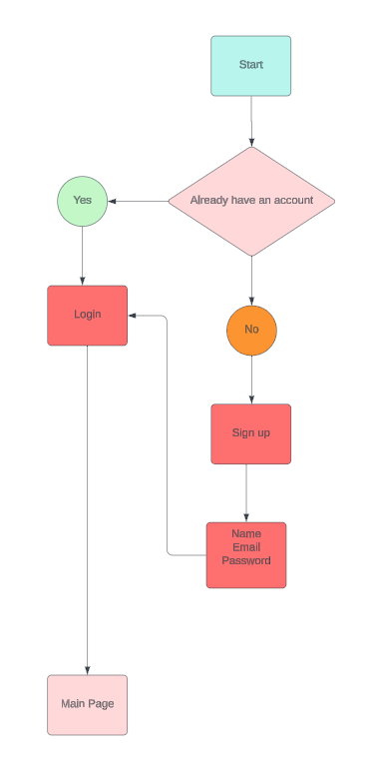
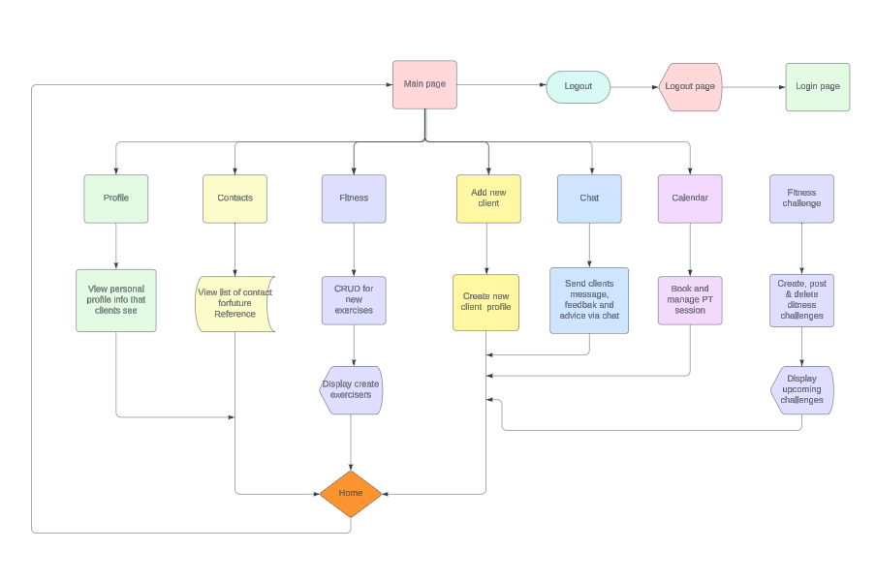
User flow

Slide 8
demo

Slide 9

Future plans
Add more functionality to the app.
Create UI for clients to use.

Slide 10
CONCLUSION
Thanks for listening ☺

